Slide 1
SOSA
Submitted to : Prof. Alex Illiev

Slide 2
Introduction
Our mission is to revolutionise the way people shop by giving them innovative and alternatives to traditional shopping. Using the cutting edge technology in their delivery model helps them to cut price, deliver quality products on time.

Slide 3
Libraries
Gluon
Recaptcha

Slide 4
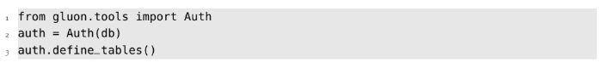
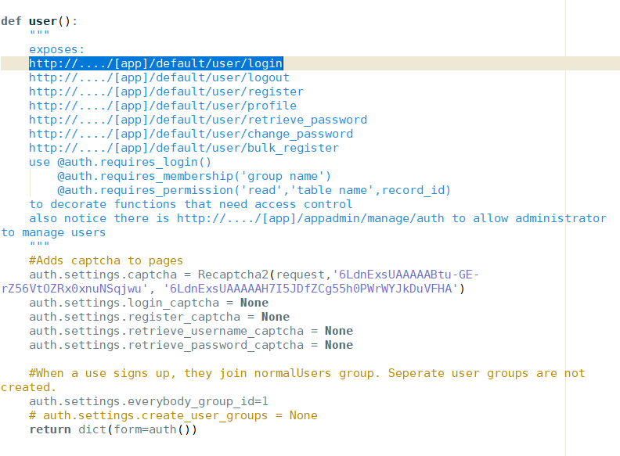
Sign Up

Slide 5
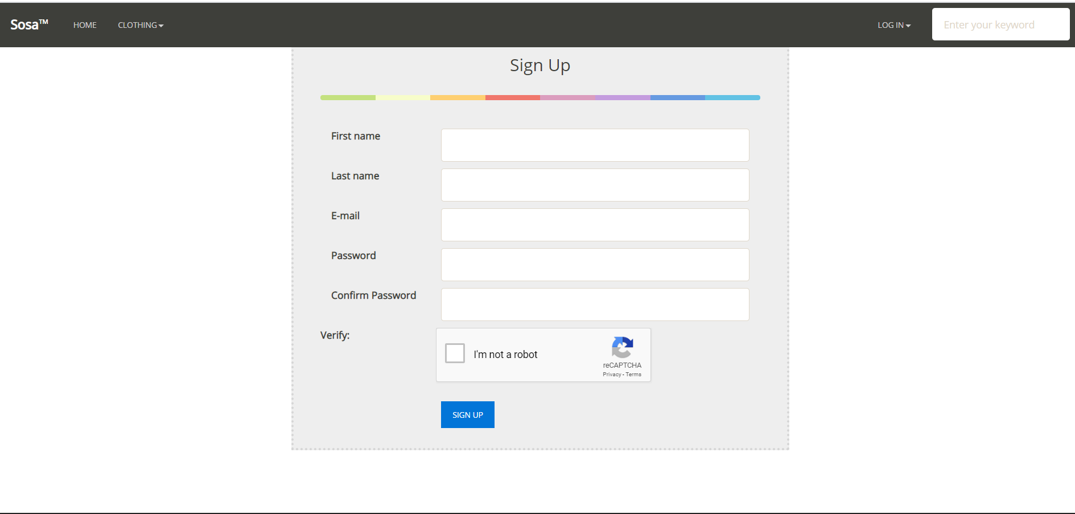

Slide 6
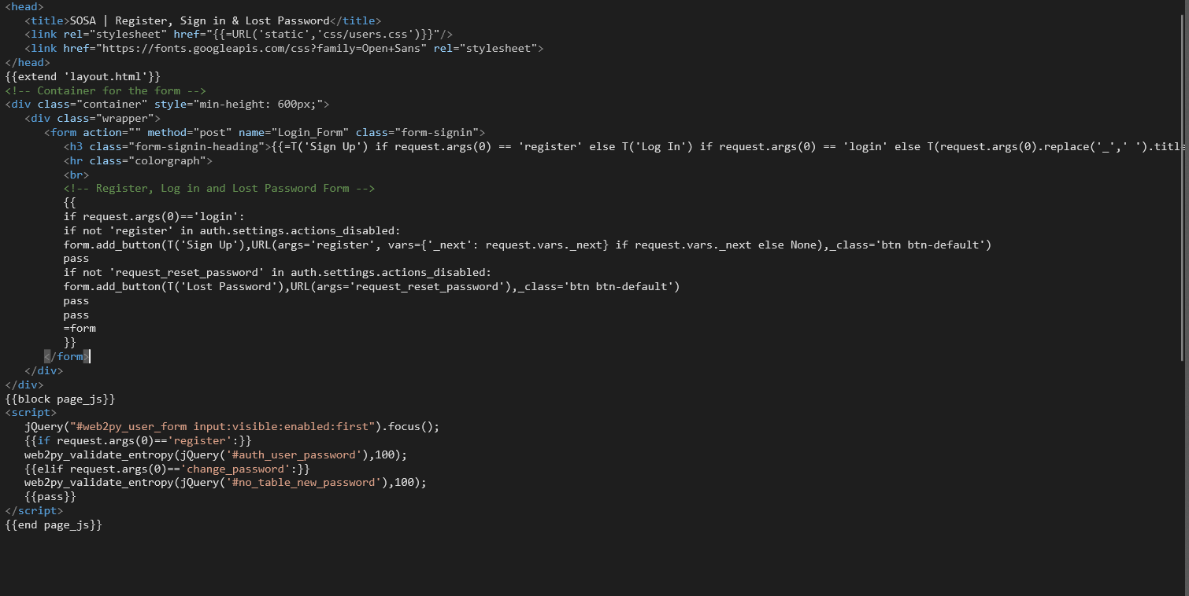
The Auth object of User is already defined in scaffolding application
The form objects is returned to the View to render an Html

Slide 7
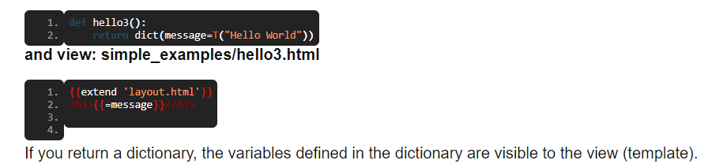
If you return a variable in the form of dictionary then it needs to be translated hence {{=T(“SignUp”)}} used
form=auth() simply displays a form & it depends on request.args(0)

Slide 8
How do you shop?
Very much same as you would shop normally .You have a shopping basket. You select items to put in the basket then you go to the checkout and pay!
Shopping online follows this procedure:
1.Sign in or register
2.Make your selection
3. Add it to your shopping basket
4.view the shopping basket
5.Proceed to checkout make payment

Slide 9
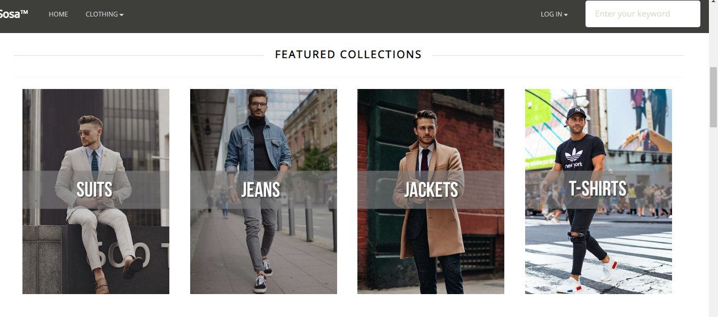
HomePage

Slide 10
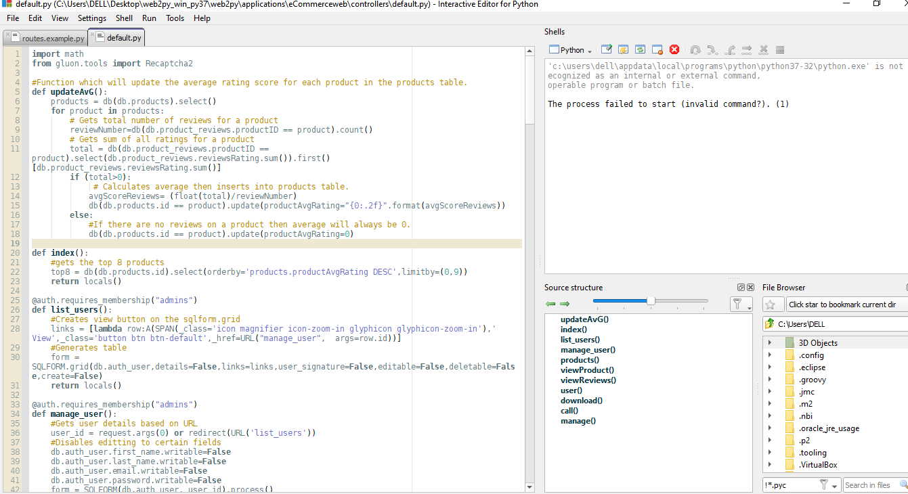

Slide 11
Website Features
Top features of our ecommerce website are :-
Shopping cart : this is the integral feature of any e-commerce website as all our products that are being selected are into this and this is where our guest can checkout.
Verification : as our guest sign up through our website, a verification code is being sent to his/her email where he/she needs to verify their account to register as our esteemed customer.
Various options : our e-commerce website has a lot of options to shop on and has various categories to which he/she has their preference to.
Ratings : which will tell us that which product is the best regarding the quality and quantity of a product

Slide 12
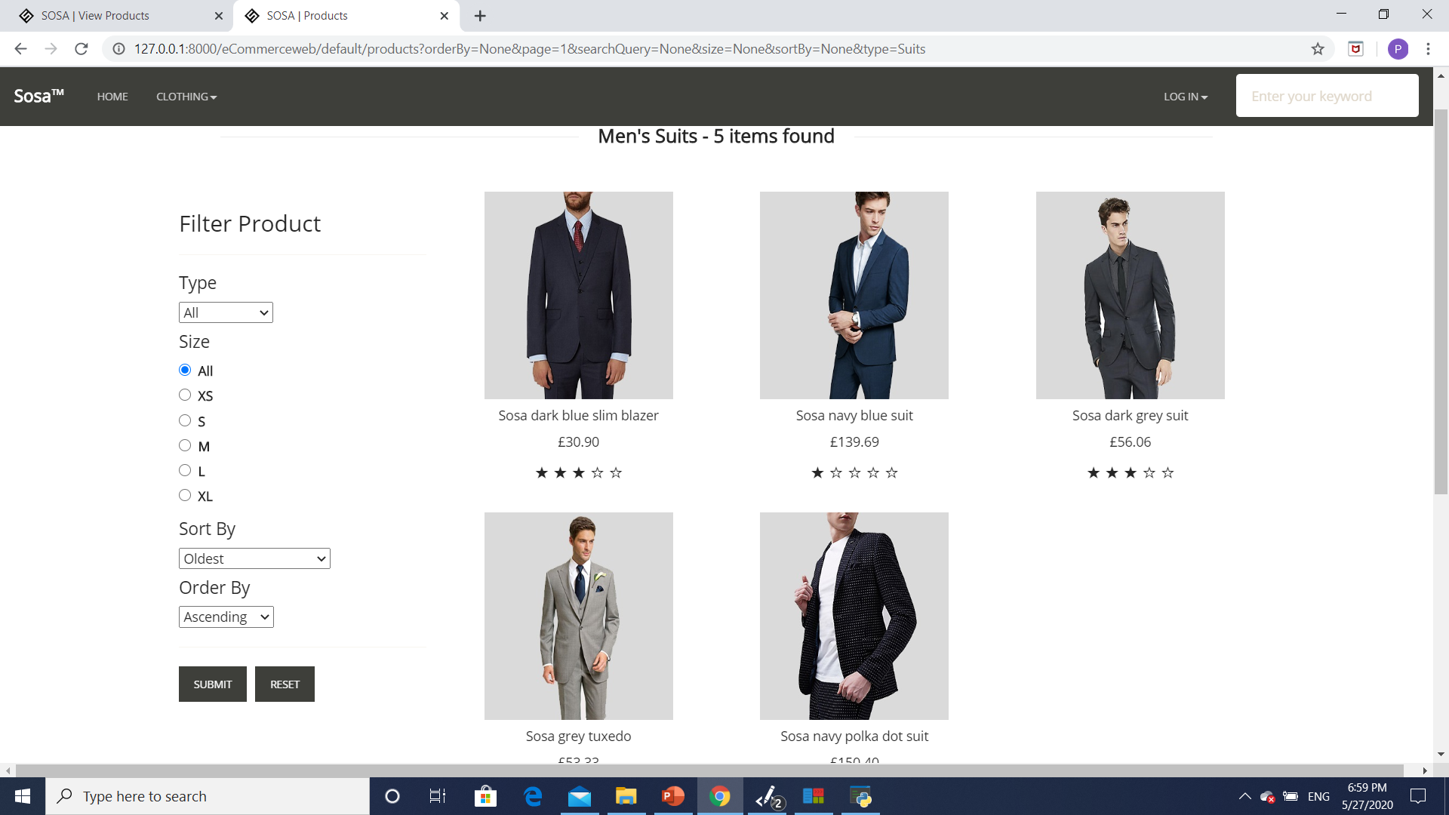
Products

Slide 13
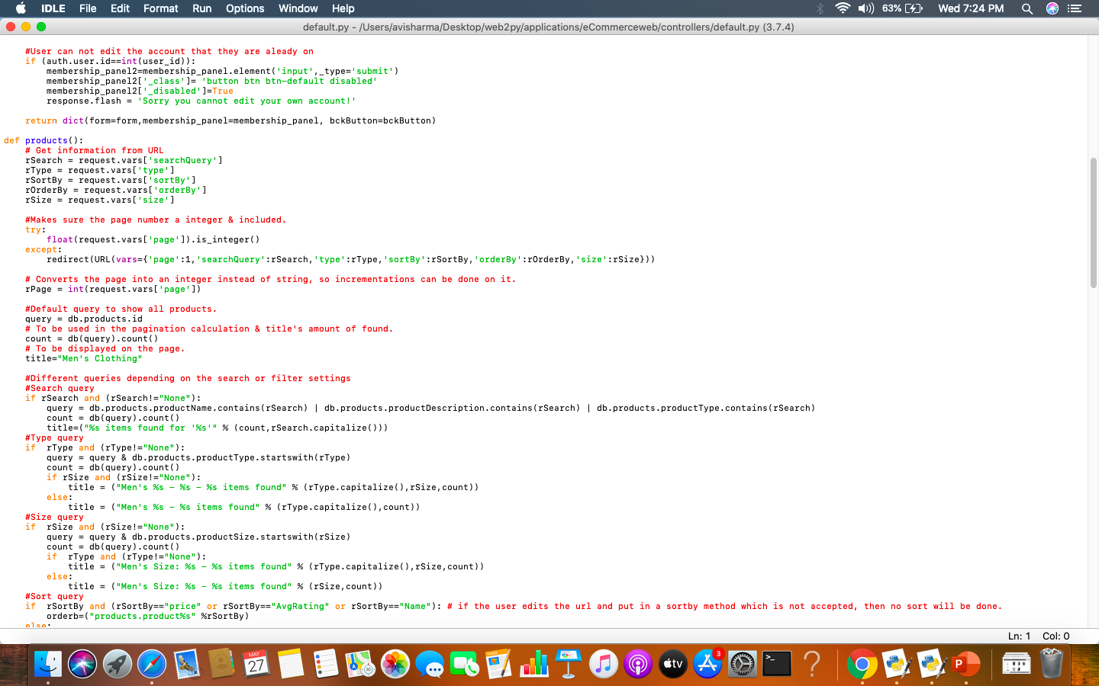

Slide 14
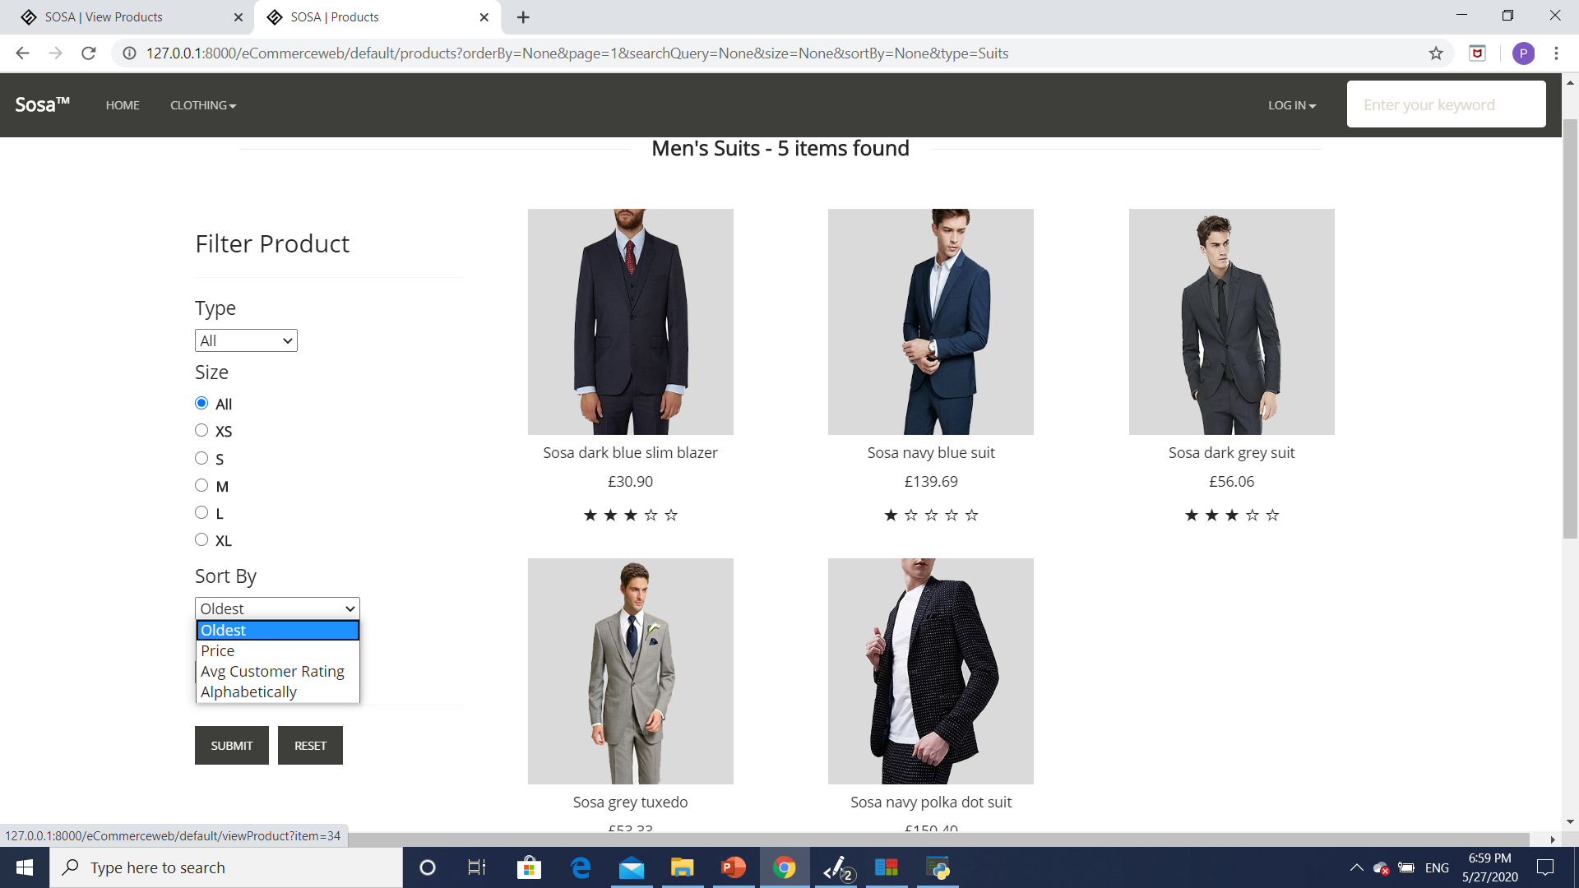

Slide 15
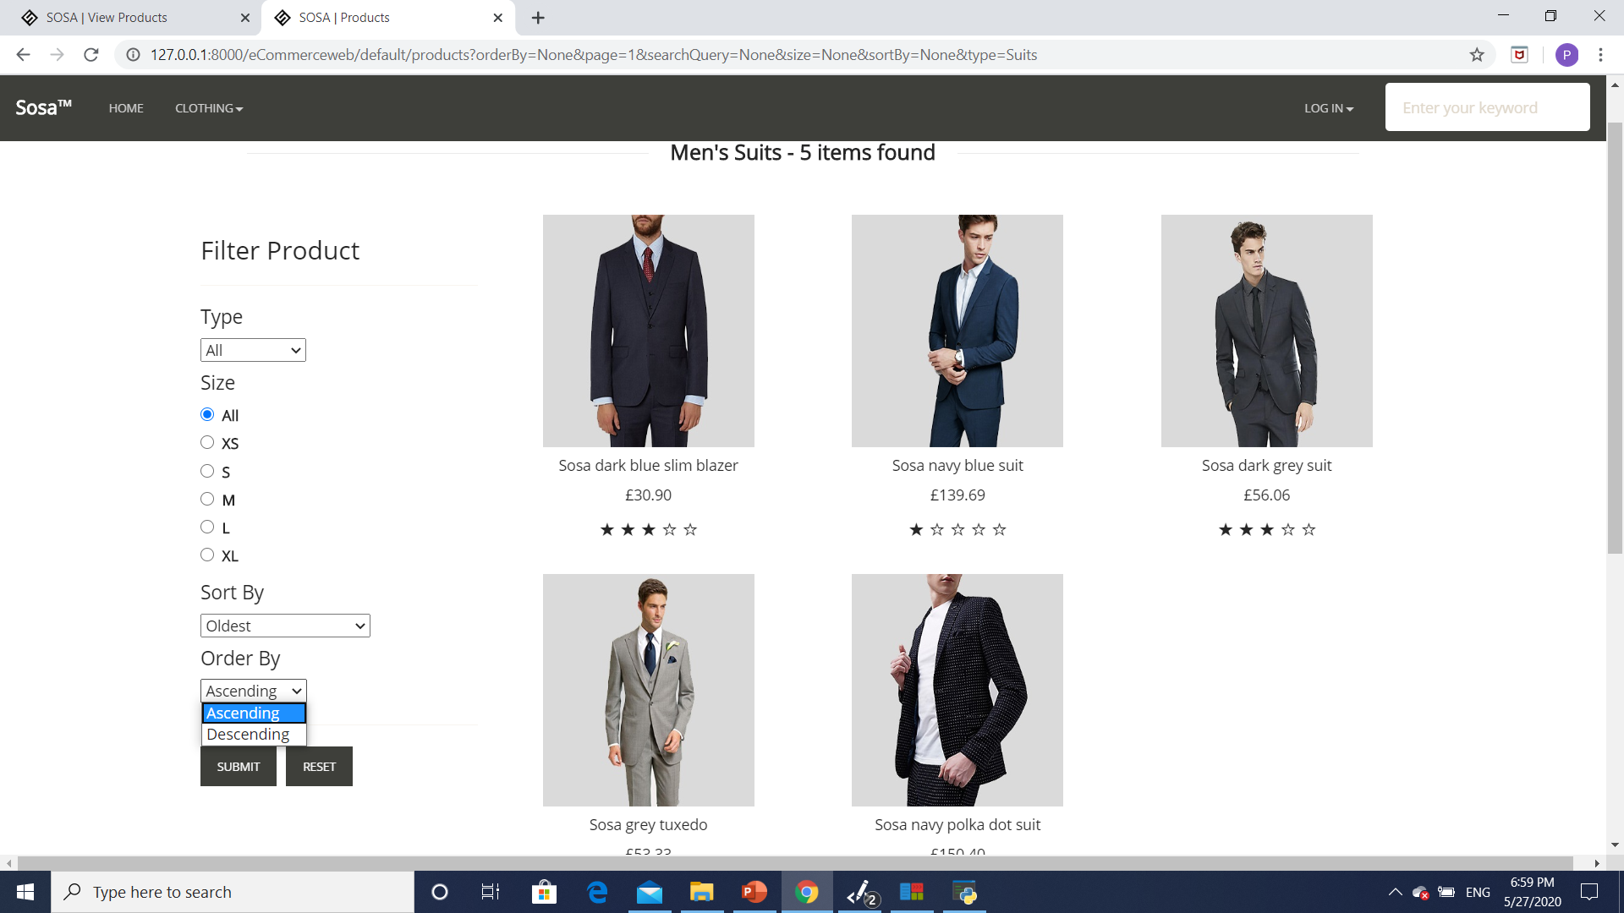

Slide 16
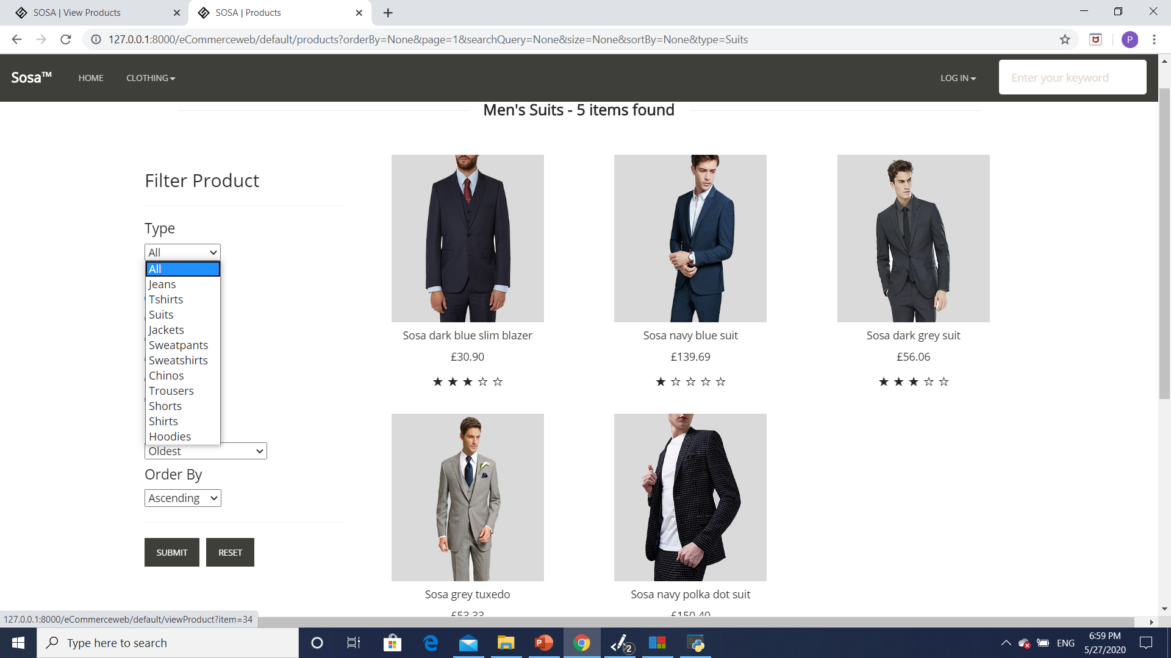

Slide 17
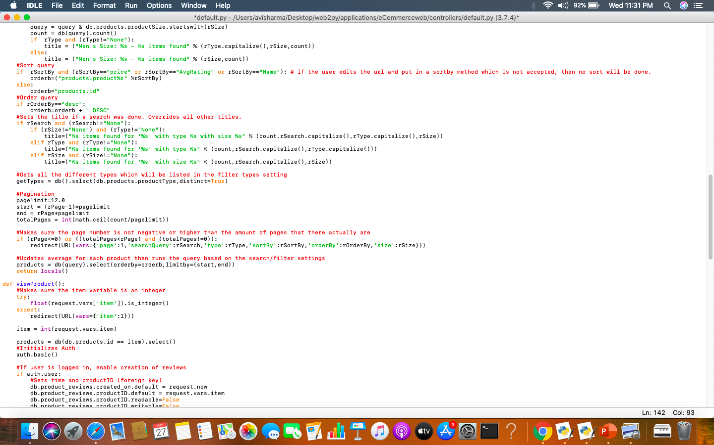

Slide 18
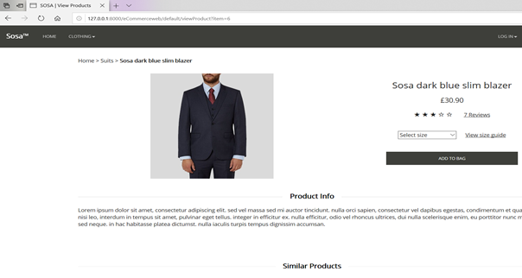
Viewing a particular product

Slide 19
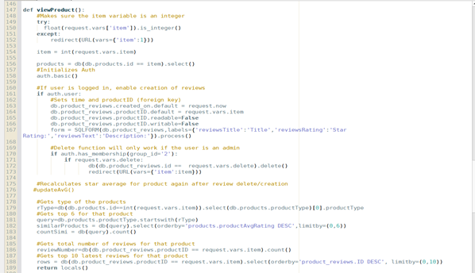
code

Slide 20
Security
SSL Certified
Safe security & Performance Monitoring

Slide 21
Advantages:
Products are cheaper
Flexible price
Buyer protection
Rare product
Extensive product mix availability
Privacy

Slide 22
Not implemented Functionality
Add to bag
Make Payment
Average Rating

Slide 23
Future implementation
Internet of things(IOT )
Advantages:
Better tracking
Personalised information
Automated shopping process

Slide 24
THANK YOU
Submitted by:
Avishkar Sharma - 3103591
Priyambada Priyadarshani - 310354o
Shaashwat Bharadwaj - 3103635
Priyanka Mishra - 3103648

